Slide 1
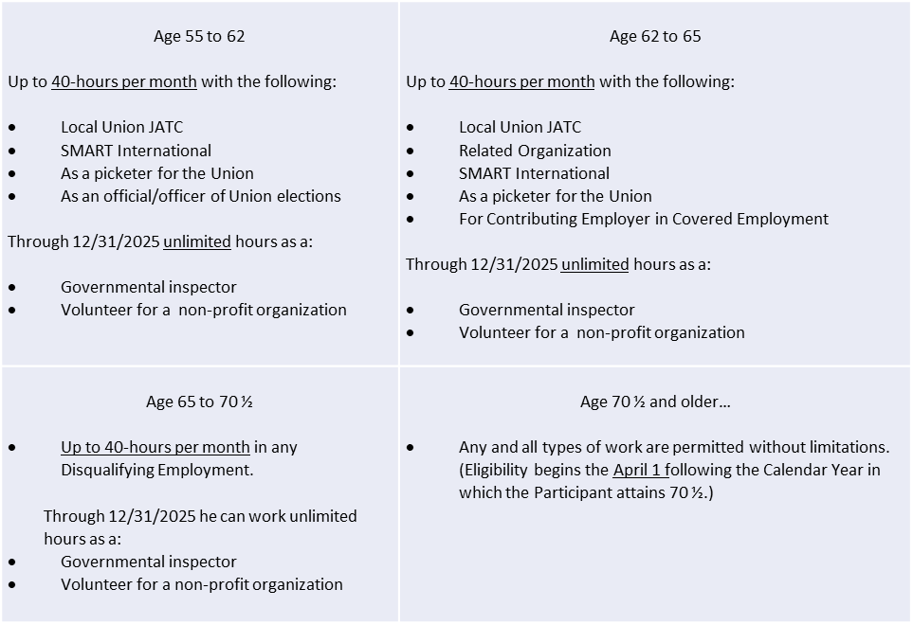
The Plan defines Disqualifying Employment, to include any employment for a Contributing Employer, or any employment with any employer in the same or related business as any Contributing Employer. It also includes any and all types of work covered by Collective Bargaining Agreements to which the Union and/or any Local are a party; or under the trade jurisdiction of the Union, as that trade jurisdiction is described in the SMART’s constitution; or in the related building trades of the Ironworkers, Plumbers and Pipefitters, Roofers, Insulators, Boilermakers, and Electrical Workers; or any other work to which a sheet metal worker has been assigned, referred, or can perform because of their skills and training as a sheet metal worker. Note that there are certain exceptions, including work in Locals with high workforce demands, as described below and in subsequent pages.
Work After Retirement
If you exceed the hours indicated on this chart, your pension will be suspended.

Slide 2
Return to Work Process for Current Retirees who wish to Suspend their Pension, Return to Work, then Re-Retire
Notify Fund Office of Return to Work
Must receive written notification 21 -days in advance of returning to work with a Contributing Employer to avoid pension overpayment. Notice can be sent to returntowork@smwnbf.org.
Monthly Pension is Placed on Hold
Pension will be suspended for every month that the retiree works with a Contributing Employer.
If less than age 62 the suspension will be no less than three months.
Notify Fund Office of Return to Retirement Date
After the appropriate suspension period the retiree is again eligible for pension.
Ideally notice is received 21-days in advance of “re-retirement.”
Re-Commencement of Pension
With the 21 day notice, pension will resume immediately at the original amount. This means that a pension check will be issued on the first of the month following the last day worked.
Benefit Review/Recalculation
Once final hours are received, there will be a review to determine if the retiree is entitled to an increase in their monthly pension as a result of the return to work. If so, that increase will apply retroactively to the re-commencement of the benefit.
1
2
3
4
5

Slide 3
Exception to Disqualifying Employment: Work in Locals with High Workforce Demands
In recognition that in certain areas of the country local unions are unable to meet the workforce demands the NPF Board of Trustees amended the Plan to allow retirees to work without a suspension of benefits provided they meet certain conditions. This exception was first available in 2023 and has been updated from time to time.
The most recent update to this exception is effective June 24, 2025 and allows retirees to work and continue to receive their pension if they meet the following conditions:
have retired prior to May 31, 2025;
work for an employer signatory to a SMART collective bargaining agreement with a local union approved by the NPF Board of Trustees and identified under Appendix H of the Plan Document. Please refer to the next page for approved local unions; and
this exception is no longer available after December 31, 2025, unless the local union has been approved or recertified through December 31, 2026, as reflected on the next page. In the instances where a determination has been made that a local union will not be recertified, the termination date of December 31, 2025, is noted.
**For information regarding the rules in effect before the most recent change contact the Fund Office at info@smwnbf.org or by phone at 703.739.7000.

Slide 4
Exception to Disqualifying Employment: Work in Locals Approved under Appendix H
Local 02 (eff. 01/2024, terminates as of 12/31/2025)
Local 05 (eff. 11/2023, terminates as of 12/31/2025)
Local 07 (eff. 05/2023)
Local 12 (eff. 07/2025 and approved through 12/31/2026)
Local 18 (eff. 05/2023)
Local 20 (eff. 08/2023)
Local 24 (eff. 05/2023)
Local 27 (eff. 08/2023 and approved through 12/31/2026)
Local 33 (eff. 04/2024)
Local 36 (eff. 08/2023, terminates as of 12/31/2025)
Local 49 (eff. 08/2023, terminates as of 12/31/2025)
Local 55 (eff. 07/2024 and approved through 12/31/2026)
Local 73 (eff. 07/2025 and approved through 12/31/2026)
Local 85 (eff. 11/2023 and approved through 12/31/2026)
Local 177 (eff. 12/2024 and approved through 12/31/2026)
Local 265 (eff. 07/2025 and approved through 12/31/2026)
Local 292 (eff. 05/2023, terminates as of 12/31/2025)
Local 359 (eff. 11/2023 and approved through 12/31/2026)

